Slide 1
Java Servlet Technology

Slide 2
In the early days of the Web, the Internet was basically a glorified file-transfer system.
A client would request a file from a server and the server would deliver the file to the client.
The files requested by the client (browser) are of the type HTML (Hyper Text File Format) and the server knows how render these files.

Slide 3
The next evolutionary step was the design of interactive web pages and dynamic content.
Paradigms like CGI (Common Gateway Interface) made it possible to run small programs on the server.
The output of these programs are HTML files which are sent back to the client.

Slide 4
Sun introduced Java Servlet, which is a small program written in Java and executed by the server.
Servlet is a compiled Java class that are executed and maintained by a Servlet container.
Servlet technology allows you to develop Java applications that generate web content.

Slide 5
A web server uses a separate module to load and run servlets.
This specialized module, which is dedicated to the servlet management, is called a servlet container, or servlet engine.
Implements life cycle methods, manages security etc.

Slide 6
Servlet Access Model
Web Server
Servlet Container
Client
HTTP request
Invokes Servlet
Other
Services
Servlet
Gives response
Client readable response
Servlet
Servlet

Slide 7
The request object Key Elements
Http Method (the action to be performed)
(get or post)
The page to access (a url)
Form parameters

Slide 8
The response object Key elements
Status code whether the request was successful or not
Content-Type (text,picture,html)
The content

Slide 9
What is a Servlet Container
It is a java application that controls the life cycle of a servlet,since servlet does not have a main method().
Eg: Tomcat,Jboss etc.

Slide 10
What does the container give you
Lifecycle management
Communications support
Mutilthreading support
Declarative Security
Jsp Support

Slide 11
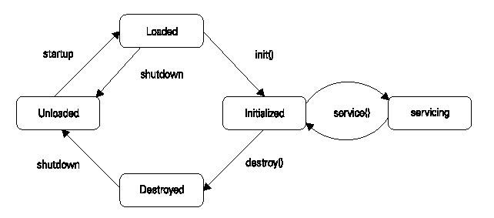

Slide 12
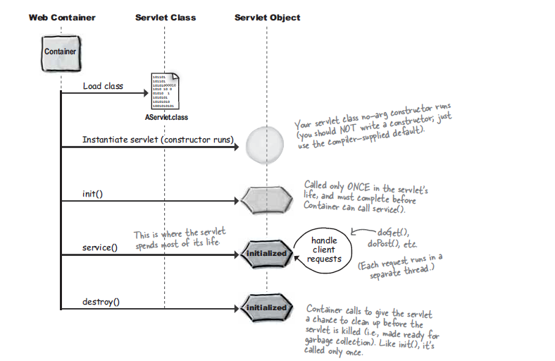
Life cycle of a servlet

Slide 13
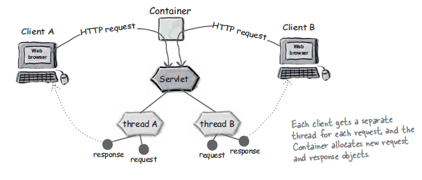
Each Request runs in it’s own thread

Slide 14
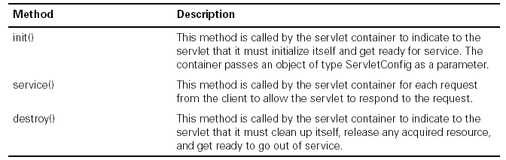

Slide 15
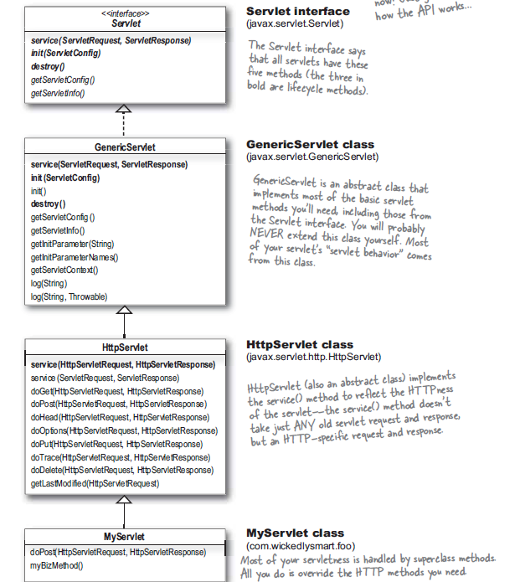

Slide 16
javax.servlet
javax.servlet.http
The javax.servlet.Servlet interface
This is the central interface in the Servlet API.
Every servlet class must directly or indirectly implement this interface. It has five methods
init()
destroy()
service()
getServletConfig()
getServletInfo()

Slide 17
javax.servlet.GenericServlet class
javax.servlet.ServletRequest interface
javax.servlet.ServletResponse interface
Javax.servlet.ServletConfig interface
Javax.servlet.ServletContext interface
javax.servlet.http.HttpServlet class
javax.servlet.http.HttpServletRequest
javax.servlet.http.HttpServletResponse interface

Slide 18

Sending HTTP Requests

Slide 19


Slide 20
GET Vs POST
GET
Exposes data through browser URL
Browsers restrict the character size of query string to be 255 characters.
POST
Is more secured way of posting page data
No size restrictions as such.

Slide 21
<html>
<body>
<form name="Form1“ method=“Get” action="http://localhost:8080/servlet/TestServlet">
<B>Credit Card Type:</B>
<select name=“ccType" size="1">
<option value=“Visa”>Visa</option>
<option value=“Master">Master</option>
</select>
<br><br>
<input type=submit value="Submit">
</form>
</body>
</html>

Slide 22
Get Vs Post by Example (cont..)
In the HTTP GET Request, the URL sent from the browser to the server is -http://localhost:8080/servlet/TestServlet?ccType=Master
In the HTTP POST Request, the URL sent from the browser to the server is - http:/localhost:8080/servlet/TestServlet

Slide 23
Make the class public.
Have the class extend GenericServlet or HttpServlet ???
Optionally have the class implement SingleThreadModel ???.
Optionally override the Servlet interface methods with your business implementation.
You should override a handling methods with your request/response logic.

Slide 24
You can use the HttpServletRequest interface associated with HTTP servlets to retrieve:
Session information ???
Remote user information???
HTTP meta information???
Path information and query (header)???
Http://localhost:9080/Testservlet/extra/info?val1=cool&val2=sth

Slide 25
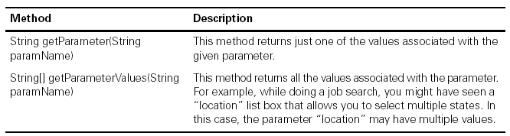

Slide 26
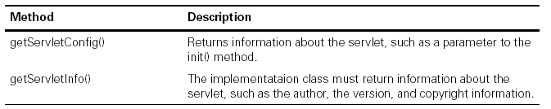
Other Methods of Request

Slide 27
Interface
Description
ServletRequest
Used to read the data from a client
ServletResponse
Used to send the data to a client
SingleThreadModel
Indicates that the servlet is thread safe

Slide 28
Interface
Description
ServletRequest
Used to read the data from a client
ServletResponse
Used to send the data to a client
SingleThreadModel
Indicates that the servlet is thread safe

Slide 29
Interface
Description
GenericServlet
Implements Servlet and ServletConfig interfaces.
ServletInputStream
Provides input stream for requests from a client.
ServletOutputStream
Provides an output stream for writing responses to a client

Slide 30
Interface
Description
HttpServletRequest
Enables to read the data from a client over HTTP.
HttpServletResponse
Enables to write the data to an HTTP response
HttpSession
Allows session data to be stored and retrieved

Slide 31
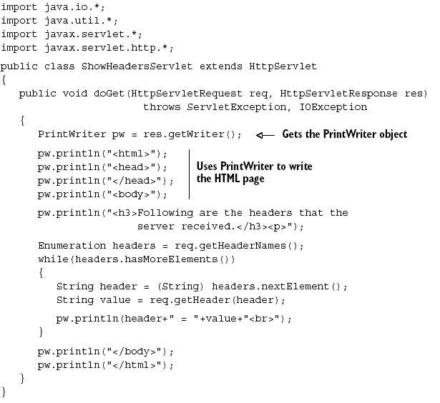

Slide 32
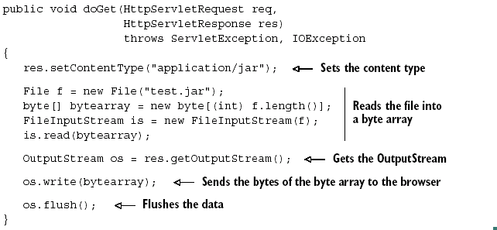
Sending the Response (cont..)

Slide 33
Session Management
Cookies : uses header line of http response message
URL Rewriting:
encodeURL(String url);
encodeRedirectURL(String url);
Hidden Forms
Session Object
getSession(boolean create);
getSession();

Slide 34
How to define the timeout limit (cont..):
setting the timeout through HttpSession interface:
void setMaxInactiveInterval(int seconds);
int getMaxInactiveInterval();
Time in seconds
<0 means session never expires

Slide 35
